Slide 1
CPSC 583 Expert Systems Design Theory
Dr. Anand Panangadan
apanangadan@fullerton.edu

Slide 2
Expert system: facts + rules
Where are the facts?!
Can we use the explosion of information since the Web was invented?

Slide 3
Semantic Web

Slide 4
The problem?
“The web has made people smarter. We need to understand how to use it to make machines smarter, too.”
-- Michael I. Jordan, UC Berkeley

Slide 5
Today’s Web
Currently most of the Web content is suitable for human use.
Typical uses of the Web today are information seeking, publishing, and using, searching for people and products, shopping, reviewing catalogues, etc.
Dynamic pages generated based on information from databases but without the original structure in the databases.

Slide 6
Limitations of Web search
The Web search results are high recall, low precision.
Results are highly sensitive to vocabulary.
Results are single Web pages.
Most of the publishing contents are not structured to allow logical reasoning and query answering.

Slide 7
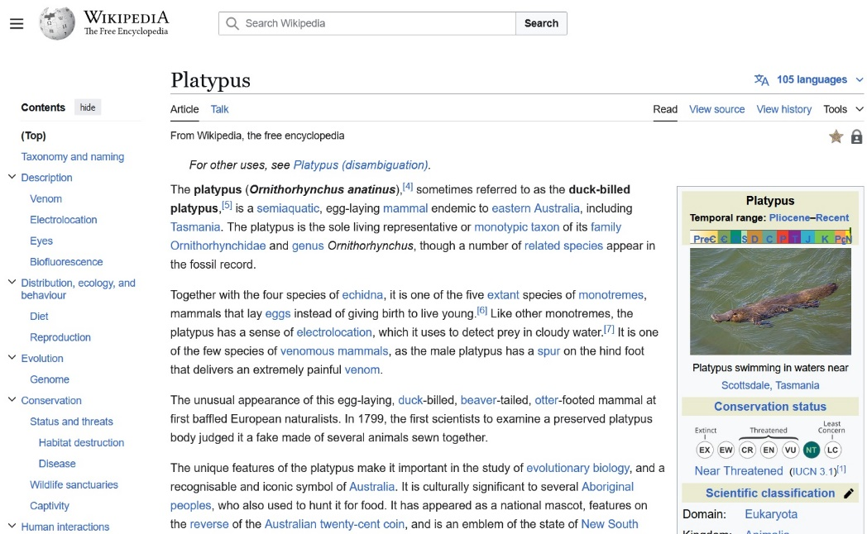
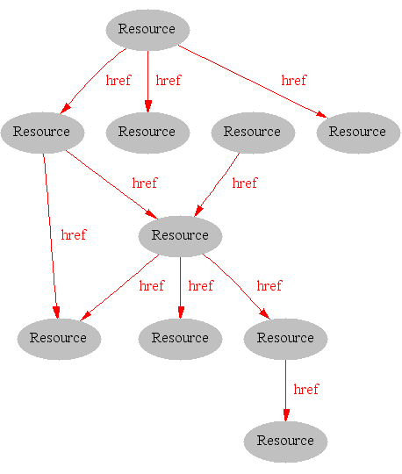
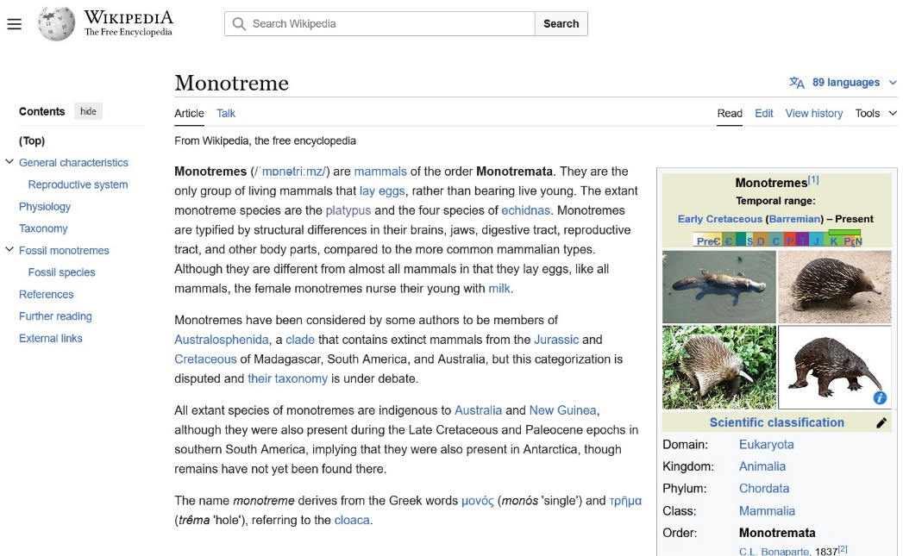
The Syntactic Web
[Hendler & Miller 02]

Slide 8
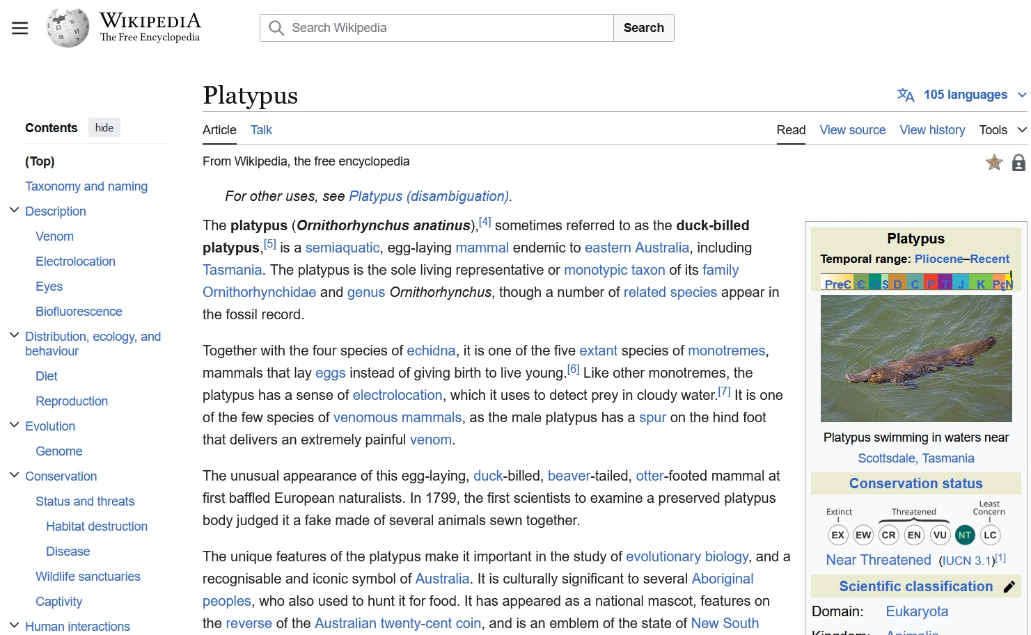
Consider a typical web page
Markup consists of:
rendering information (e.g., font size and colour)
Hyperlinks to related content
Semantic content is accessible to humans but not (easily) to computers
[Davies, 03]

Slide 9
i.e. the Syntactic Web is…
A place where
computers do the presentation (easy) and
people do the linking and interpreting (hard).
Why not get computers to do more of the hard work?
[Goble, 03]

Slide 10
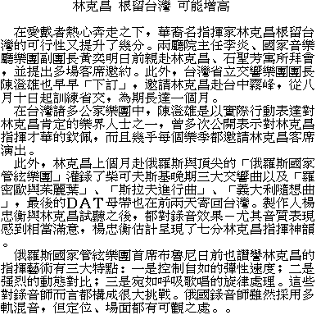
What about XML?
name
education
CV
work
private
[Davies, 03]

Slide 11
XML
User definable and domain specific markup
HTML:
<H1>Internet and World Wide Web</H1> <UL>
<LI>Code: G52IWW <LI>Students: Undergraduate </UL>
XML:
<module> <title>Internet and World Wide Web</title> <code>G52IWW</code> <students>Undergraduate</students> </module>

Slide 12
XML: Document = labeled tree
node = label + contents
<module date=“...”> <title>...</title> <lecturer>
<name>...</name>
<weblink>...</weblink>
</lecturer> <students>...</students> </module>
module
=
title
lecturer
students
name
weblink
document type definition (DTD): describe the grammar and structure of permissible XML trees

Slide 13
But XML tags don’t have a commonly accepted meaning
< ναμε >
< >
name
<εδυχατιον>
< >
education
< Χς >
< >
CV
<ωορκ>
< >
work
<πριϖατε>
< >
private
[Davies, 03]

Slide 14
XML
Meaning of XML-Documents is intuitively clear
Due to "semantic" Mark-Up
Understandable by humans
Tags are domain-terms
But computers do not have intuition
tag-names do not provide semantics for machines
DTDs or XML Schema specify the structure of documents, not the meaning of the document contents
XML lacks a semantic model
has only a "surface model”, i.e. tree

Slide 15
XML: limitations for semantic markup
XML representation makes no commitment on:
Domain specific vocabulary
Which words shall we use to describe a given set of concepts?
Primitives for combining concepts
How to combine these concepts, e.g. “car is a-kind-of (subclass-of) vehicle”
⇨ requires pre-arranged agreement on vocabulary and primitives

Slide 16
XML is a first step
Semantic markup
HTML ⇨ layout
XML ⇨ content
Metadata
within documents, not across documents
prescriptive, not descriptive
No commitment on vocabulary and modelling primitives
RDF is the next step
[Davies, 03]

Slide 17
The solution(?)
“The Semantic Web is an extension of the current web in which information is given well-defined meaning, better enabling computers and people to work in co-operation.”
-- Tim Berners-Lee, inventor of the WWW

Slide 18
semantic web and Semantic Web
semantic web
The idea of a web of machine understandable information
Does not commit to the technology used to support it
May involve more AI (e.g., NLP)
Semantic Web
The current vision of a semantic web as defined by the W3C community: a web of data
Using W3C supported standards (i.e., RDF, OWL, SPARQL, XML)
For machines to support human-oriented applications

Slide 19
Semantic Web languages today
RDF – Resource Description Framework http://www.w3.org/RDF/
OWL – Ontology Web Language http://www.w3.org/2001/sw/

Slide 20
Resource Description Framework (RDF)
A standard of W3C
Relationships between documents
Consisting of triples or sentences:
<subject, property, object>
<“Mozart”, composed, “The Magic Flute” >
Notes:
RDF is an XML application defined using a document type definition (DTD). A DTD was used because the design of RDF essentially pre-dates XML schema.
RDF is made up of triples which are like simple grammatical sentences with a subject, a verb and an object (in that order). The subject and the verb will be a URI, the object may be a URI or may be a literal. A literal is a character string or other primitive datatype defined by XML.
The uniqueness of the URI convention prevents confusion. Frequently the URI will be a URL where information about the data is stored. E.g. if I want to represent myself (Paul Warren) uniquely then I can create a URL somewhere (with a reasonable chance of guaranteeing persistence). The URL may have a descriptive identifier, e.g. …johnDavies.htm - but this is merely incidental. The page pointed at should preferably say something about the fact that the URL represents me. What we do require is that the URL be persistent.
Someone else, e.g. the tax office, may construct a URI representing me, and all the intelligent agents in the world will be blissfully ignorant that the two URIs refer to the same person … until a human intervenes and defines an equivalence between them.
Besides URLs, other forms of URI include identification of electronic mailboxes.

Slide 21
The RDF Data Model
An RDF document is an unordered collection of statements, each with a subject, predicate and object (aka triples)
A triple can be thought of as a labelled arc in a graph
Statements describe properties of web resources
A resource is any object that can be pointed to by a URI:
a document, a picture, a paragraph on the Web, …
E.g., http://umbc.edu/~finin/cv.html
a book in the library, a real person (?)
isbn://5031-4444-3333
…
Properties themselves are also resources (URIs)

Slide 22
RDF
Basic building block: subject-property-value triple
Called a statement
Example:
[Washington, DC] [is-capital-of] [USA]
Set of triples make a document

Slide 23
RDF: Basic Ideas
Resources
Every resource has a URI (Universal Resource Identifier)
A URI can be a URL (a web address) or a some other kind of identifier;
An identifier does not necessarily enable access to a resources
We can think of a resource as an object that we want to describe:
Book
Person
Place, etc.

Slide 24
URIs are the foundation
URI = Uniform Resource Identifier
"The generic set of all names/addresses that are short strings that refer to resources"
URLs (Uniform Resource Locators) are a subset of URIs, used for resources that can be accessed on the web
URIs look like “normal” URLs, often with fragment identifiers to point to a document part:
http://foo.com/bar/mumble.html#pitch
URIs are unambiguous
the web provides a global namespace
We assume references to the same URI are to the same thing

Slide 25
What does a URI mean?
Sometimes URIs denote a web resource
http://umbc.edu/~finin/finin.jpg denotes a file
We can use RDF to make assertions about the resource, e.g., it’s an image and depicts a person with name Tim Finin, …
Sometimes concepts in the external world
http://umbc.edu/ denotes a particular University located in Baltimore
Distinguished by content negotiation
HTTP 303 status code

Slide 26
RDF: Basic Ideas
Properties
Properties are special kind of resources;
Properties describe relations between resources.
For example: “written by”, “composed by”, “title”, “topic”, etc.
Properties in RDF are also identified by URIs.
This provides a global, unique naming scheme.

Slide 27
Values
Values can be resources or literals
Literals are atomic values
Example
<#pat> <#knows> <#jo> .
<#pat> <#age> 24 .

Slide 28
Data Types
^-notation indicates the type of a literal
Most widely used data typing scheme is XML Schema
XML Schema predefines a large range of data types
E.g. Booleans, integers, floating-point numbers, times, dates, etc.
Example
(#David Billington, http://www.mydomain.org/age, “27”^http://www.w3.org/2001/XMLSchema#integer)

Slide 29

RDF triple = Edge in a graph
A directed graph with labeled nodes and arcs
from the resource (the subject of the statement)
to the resource/value (the object of the statement)
Known in AI as a semantic net
The value of a statement may be a resource
Ιt may be linked to other resources

Slide 30
RDF for semantic annotation
RDF provides metadata about Web resources
Subject -> Property/Attribute-> Value triples
It can have an XML syntax
Chained triples form a graph
http://sepang.nottingham.edu.my/~bpayam/images/payam-barnaghi.png
has_image
http://sepang.nottingham.edu.my/~bpayam/#Payam
UNiM
#Payam
has_email
payam@nottingham
has_owner
has_teaching
http://www.nottingham.edu.my/CSIT/G53ELC
<rdf:Description rdf:about=“#Payam”>
<has_email>payam@nottingham</has_email>
</rdf:Description>
Notes:
RDF has reification. Graph data model, property-centric approach.

Slide 31
Three Views of a Statement
A triple
A piece of a graph
A piece of XML code
Thus an RDF document can be viewed as:
A set of triples
A graph (semantic net)
An XML document

Slide 32
Serializing RDF
Graph
XML Encoding
RDF
Data Model
<rdf:RDF ……..>
<….>
<….>
</rdf:RDF>
Good For
Human Viewing
Good for
Machine Processing
Triples
stmt(docInst, rdf_type, Document)
stmt(personInst, rdf_type, Person)
stmt(inroomInst, rdf_type, InRoom)
stmt(personInst, holding, docInst)
stmt(inroomInst, person, personInst)
RDF is a simple language for building graph based representations
Good For
Reasoning

Slide 33
N3 notation for RDF
XML is largely unreadable and even harder to write
N3 is a compact notation for RDF that is easier for people to read, write and edit.
Aka Notation 3, developed by Tim Berners-Lee.
Translators exist between N3 and the XML encoding
“syntactic sugar”

Slide 34
N3 triple representation
RDF triples have one of two forms:
<URI> <URI> <URI>
<URI> <URI> <quoted string>
Triples are easily stored and managed in DBMS
Flat nature of a triple a good match for relational DBs

Slide 35
RDF Example
http://umbc.edu/ ~finin/talks/idm02/
dc:Title
“Intelligent Information Systems on the Web and in the Aether”
dc:Creator
blank node
bib:Aff
http://umbc.edu/
bib:email
bib:name
“Tim Finin”
“finin@umbc.edu”

Slide 36
N3 triple representation
<http://umbc.edu/~finin/talks/idm02/> <http://purl.org/dc/elements/1.1/Title> "Intelligent Information Systems on the Web and in the Aether" .
_:j10949 <http://daml.umbc.edu/ontologies/bib/Name> "Tim Finin" .
_:j10949 <http://daml.umbc.edu/ontologies/bib/Email> "finin@umbc.edu" .
_:j10949 <http://daml.umbc.edu/ontologies/bib/Aff> <http://umbc.edu/> .
<http://umbc.edu/~finin/talks/idm02/> <http://purl.org/dc/elements/1.1/Creator> _:j10949 .

Slide 37
Class work
Represent the following facts as a Semantic Web:
Davis, Sacramento, and Phoenix are Cities. Davis and Sacramento are located in California. Phoenix is located in Arizona. Davis has a population of 68,986. Sacramento has a population of 501,901. Phoenix has a population of 1,445,632.
Use only three properties:
is-located-in
hasPopulation
rdf:type
Show two representations
A graph
A set of triples
Davis
rdf:type
City

Slide 38
Triples as logical formula
The triple (x,P,y) can be considered as a logical formula P(x,y)
Binary predicate P relates object x to object y
RDF offers only binary predicates

Slide 39
Binary Predicates
RDF uses only binary properties
How to represent predicates with more than 2 arguments?
Represent using multiple binary predicates
Example: referee(X,Y,Z)
X is the referee in a chess game between players Y and Z

Slide 40
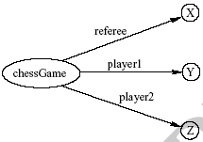
Binary Predicates
We introduce:
a new auxiliary resource chessGame
the binary predicates ref, player1, and player2
We can represent referee(X,Y,Z) as:

Slide 41
Class work
Represent these two predicates as a Semantic Web:
Flight(LAX, JFK, United, 336 minutes)
Flight(JFK, LAX, Delta, 370 minutes)
Origin
LAX
Flight1
JFK
Destination

Slide 42
Class work
Represent these two predicates as a Semantic Web:
Flight(LAX, JFK, United, 336 minutes)
Flight(JFK, LAX, Delta, 370 minutes)
Origin
LAX
Destination
Flight1
JFK
Flight2
Destination
Airline
United
Duration
336

Slide 43
RDF Schema
RDF Schema extends RDF with standard “ontology vocabulary”:
Class, Property
Type, subClassOf
domain, range
Notes:
RDF is an XML application defined using a document type definition (DTD). A DTD was used because the design of RDF essentially pre-dates XML schema.
RDF is made up of triples which are like simple grammatical sentences with a subject, a verb and an object (in that order). The subject and the verb will be a URI, the object may be a URI or may be a literal. A literal is a character string or other primitive datatype defined by XML.
The uniqueness of the URI convention prevents confusion. Frequently the URI will be a URL where information about the data is stored. E.g. if I want to represent myself (Paul Warren) uniquely then I can create a URL somewhere (with a reasonable chance of guaranteeing persistence). The URL may have a descriptive identifier, e.g. …johnDavies.htm - but this is merely incidental. The page pointed at should preferably say something about the fact that the URL represents me. What we do require is that the URL be persistent.
Someone else, e.g. the tax office, may construct a URI representing me, and all the intelligent agents in the world will be blissfully ignorant that the two URIs refer to the same person … until a human intervenes and defines an equivalence between them.
Besides URLs, other forms of URI include identification of electronic mailboxes.

Slide 44
RDF Schema
RDF is a universal language that enables users to describe their own vocabularies
But RDF does not place any restrictions about what is allowed/not allowed in any particular domain
User defines this using RDF Schema (RDFS)

Slide 45
What does RDF Schema add?
Defines vocabulary for RDF
Organizes this vocabulary in a typed hierarchy
Class, subClassOf, type
Property, subPropertyOf
domain, range
Staff
subClassOf
subClassOf
Schema(RDFS)
Lecturer
domain
range
Research Assistant
supervisedBy
type
type
Tom
supervisedBy
Alan
Data(RDF)
[adapted from: Studer et al, 04]

Slide 46
Why Classes are Useful
Impose restrictions on what can be stated in an RDF document using the schema

Slide 47
Why Classes are Useful
DiscreteMath is-taught-by Calculus ✗
We want courses to be taught by lecturers only
Restriction on values of the property “is taught by”
range restriction
RoomMZH5760 is-taught-by DavidBillington ✗
Only courses can be taught
Restriction on the objects to which the property can be applied
domain restriction

Slide 48
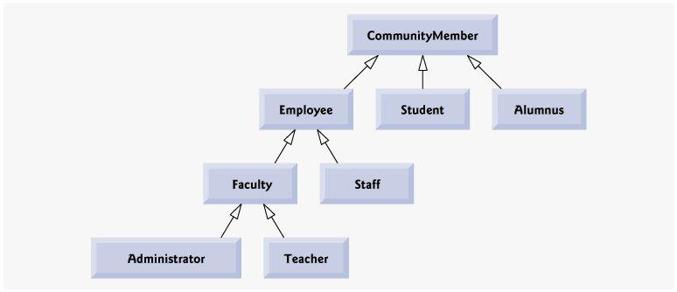
Class Hierarchy Example

Slide 49
Inheritance in Class Hierarchies
Range restriction: Courses must be taught by academic staff members only
David Billington is a professor
He inherits the ability to teach from the class of academic staff members
RDF Schema fixes the semantics of “is a subclass of”

Slide 50
Core Classes
rdfs:Resource, the class of all resources
rdfs:Class, the class of all classes
rdfs:Literal, the class of all literals (strings)

Slide 51
Core Properties
rdfs:subClassOf, relates a class to one of its superclasses
All instances of a class are instances of its superclass
rdfs:subPropertyOf, relates a property to one of its superproperties
rdfs:domain, specifies the domain of a property P
The class of those resources that may appear as subjects in a triple with predicate P
If the domain is not specified, then any resource can be the subject
rdfs:range, specifies the range of a property P
The class of those resources that may appear as values in a triple with predicate P

Slide 52
Examples
<rdfs:Class rdf:about="#lecturer">
<rdfs:subClassOf rdf:resource="#staffMember"/>
</rdfs:Class>
<rdf:Property rdf:ID="phone">
<rdfs:domain rdf:resource="#staffMember"/>
<rdfs:range rdf:resource="http://www.w3.org/
2000/01/rdf-schema#Literal"/>
</rdf:Property>

Slide 53
Utility Properties
rdfs:label A human-friendly label (name) is associated with a resource
rdfs:seeAlso relates a resource to another resource that explains it
rdfs:isDefinedBy is a subproperty of rdfs:seeAlso and relates a resource to the place where its definition, typically an RDF schema, is found
rdfs:comment Comments, typically longer text, can be associated with a resource

Slide 54
Example: A University
<rdfs:Class rdf:ID="lecturer">
<rdfs:comment>
The class of lecturers. All lecturers are academic staff members.
</rdfs:comment>
<rdfs:subClassOf rdf:resource="#academicStaffMember"/>
</rdfs:Class>
<rdfs:Class rdf:ID="course">
<rdfs:comment>The class of courses</rdfs:comment>
</rdfs:Class>
<rdf:Property rdf:ID="isTaughtBy">
<rdfs:comment>
Inherits its domain ("course") and range ("lecturer") from its superproperty "involves"
</rdfs:comment>
<rdfs:subPropertyOf rdf:resource="#involves"/>
</rdf:Property>
<rdf:Property rdf:ID="phone">
<rdfs:comment>
It is a property of staff members and takes literals as values.
</rdfs:comment>
<rdfs:domain rdf:resource="#staffMember"/>
<rdfs:range rdf:resource="http://www.w3.org/2000/01/rdf-schema#Literal"/>
</rdf:Property>

Slide 55
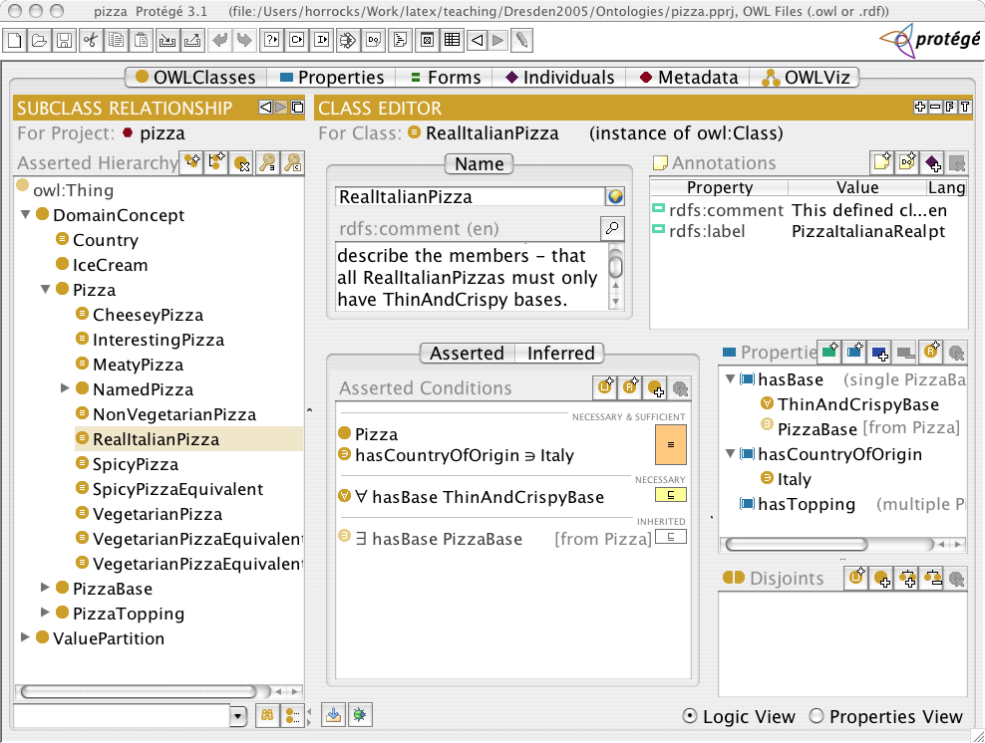
Ontology editor (Protégé)

Slide 56
Some applications

Slide 57
Database integration
How do we query data from multiple databases?
Issues?

Slide 58
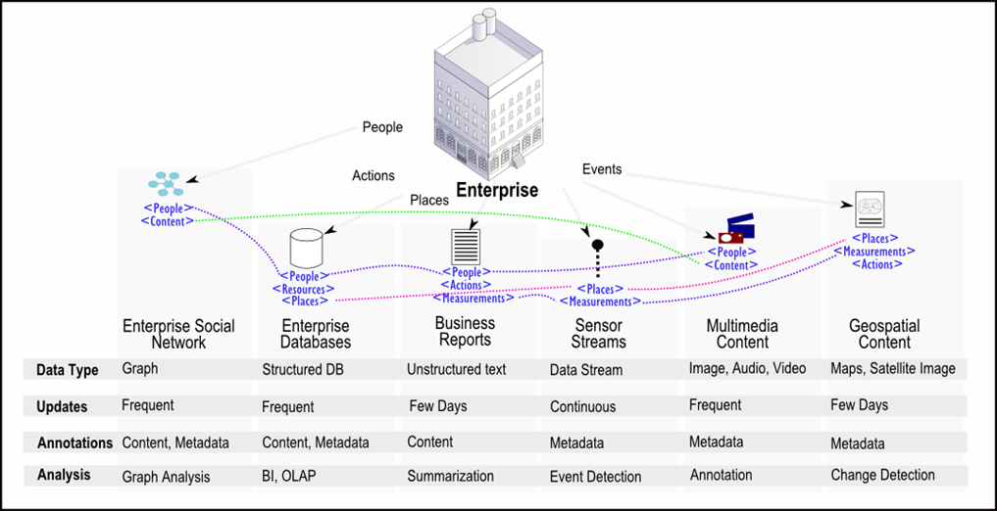
Data Integration
Sharing knowledge among different applications
Different data types and naming conventions
Manual integration -> Inefficient
Notes:
Motivation of data integration
Motivation of automatic data integration

Slide 59
Database integration
The two database need to apply a common, standard “vocabulary” to describe their data
Same term in two databases must mean the same thing
Meaning = semantics

Slide 60
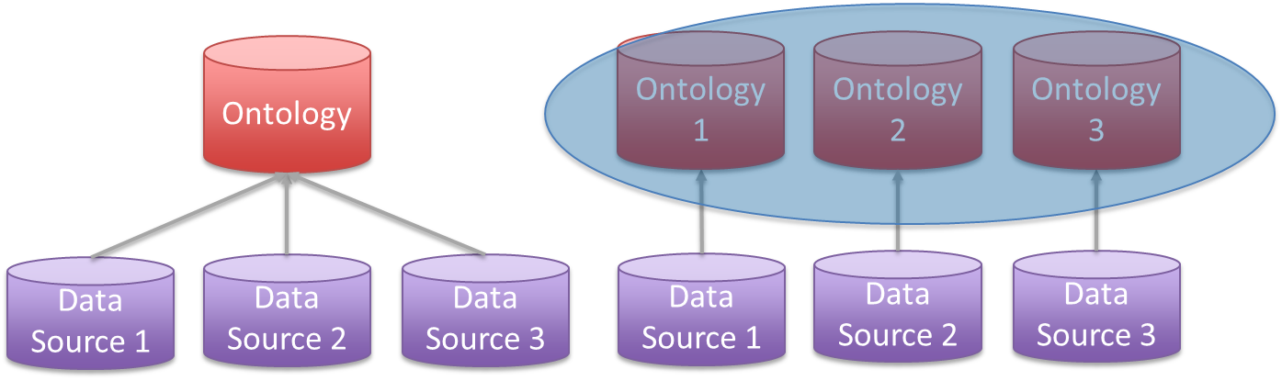
Data and Ontology Integration
Data Integration
Combine data residing in different sources and providing users with a unified view of these data.
Ontology-based Data Integration
Use ontologies to effectively combine data from multiple heterogeneous sources.
Single Ontology
Notes:
One category for data integration is ontology-based data integration
Two common approaches: single ontology and multiple ontology
For multiple ontology approach, the problem of ontology integration arises. Our work is in this problem domain.

Slide 61
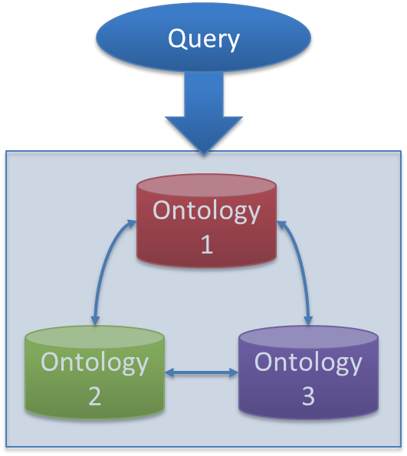
Ontology Integration Tasks
Multiple Ontologies – Ontology Integration
Matching discovery
Query execution
Notes:
Two common tasks in ontology integration: matching discovery and query execution

Slide 62
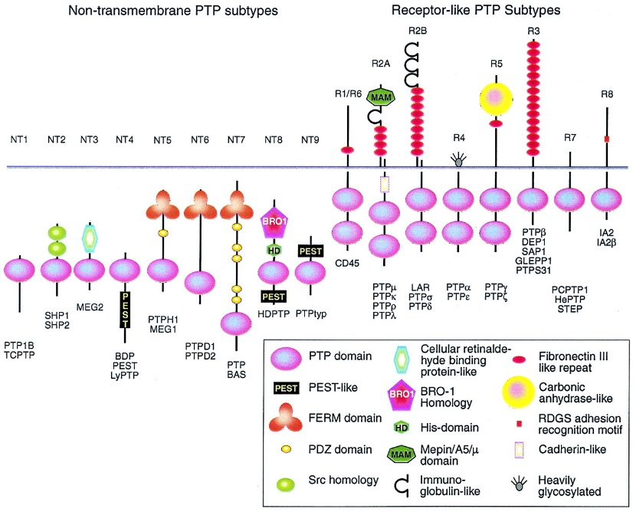
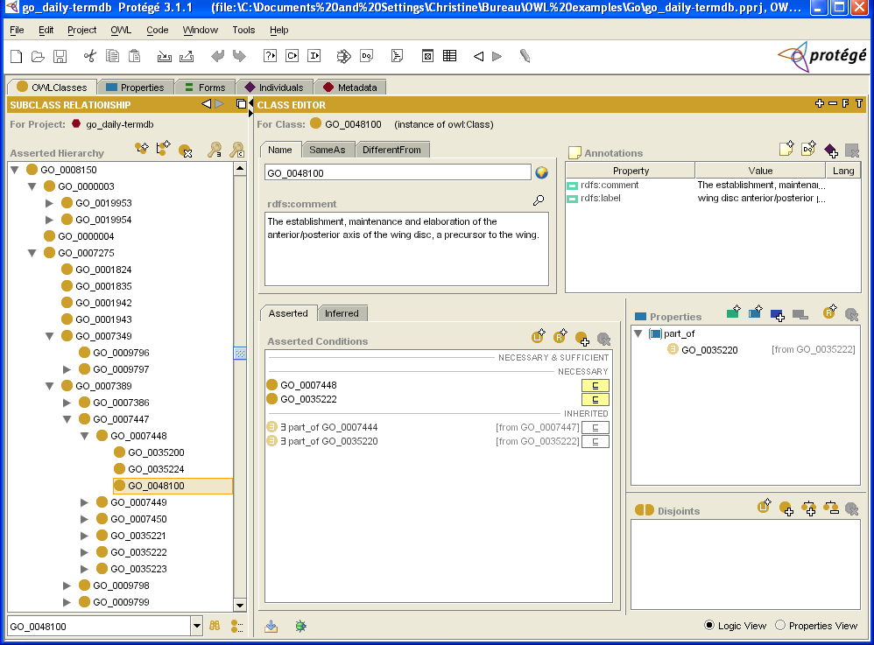
Applications of Ontologies
e-Science, e.g., Bioinformatics
Open Biomedical Ontologies Consortium (GO, MGED)
Used e.g., for “in silico” investigations relating theory and data
E.g., relating data on phosphatases to (model of) biological knowledge
Notes:
Graphic showing protein functional domains (sequences of amino acids?); the identifying characteristics of different proteins.

Slide 63
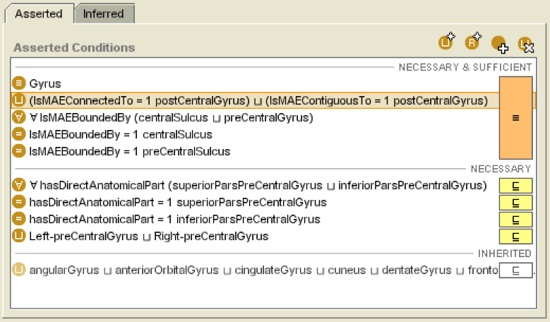
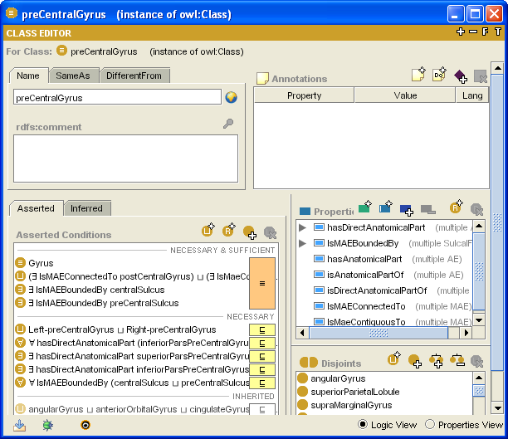
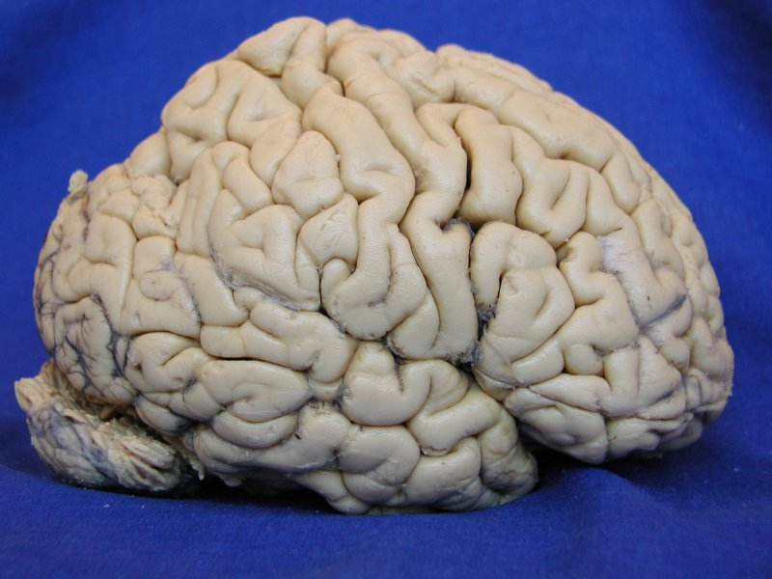
Applications of Ontologies
Medicine
Building/maintaining terminologies such as Snomed, NCI & Galen
Central Sulcus
Parietal Lobe
Frontal Lobe
Occipital
Lobe
Temporal Lobe
Lateral Sulcus
Notes:
- Example from project to (semi-) automate the annotation of MRI images of the brain
- FMA derived ontology used to capture knowledge of brain anatomy

Slide 64
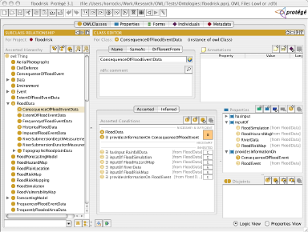
Applications of Ontologies
Organising complex and semi-structured information
UN-FAO, NASA, Ordnance Survey, General Motors, Lockheed Martin, …

Slide 65
Choosing vocabularies for RDF data
Instead of inventing a new ontology, try to reuse terms from existing ontologies:
Friend-of-a-Friend (FOAF): terms for describing people
Dublin Core (DC): terms for general metadata attributes (books, film, ...)
Semantically-Interlinked Online Communities (SIOC): terms for describing online communities
Description of a Project (DOAP): terms for describing projects
Music Ontology: terms for describing artists, albums and tracks
Review Vocabulary: terms for representing reviews

Slide 66
FOAF: Friend of a friend
“The Friend of a Friend (FOAF) project is about creating a Web of machine-readable homepages describing people, the links between them and the things they create and do. ” (http://www.foaf-project.org/)
machine-readable ontology describing persons, their activities and their relations to other people and objects
Everybody can put her own FoaF file on her own webpage.
A distributed, open social network
Reference: FOAF Vocabulary Specification 0.91: http://xmlns.com/foaf/spec/

Slide 67
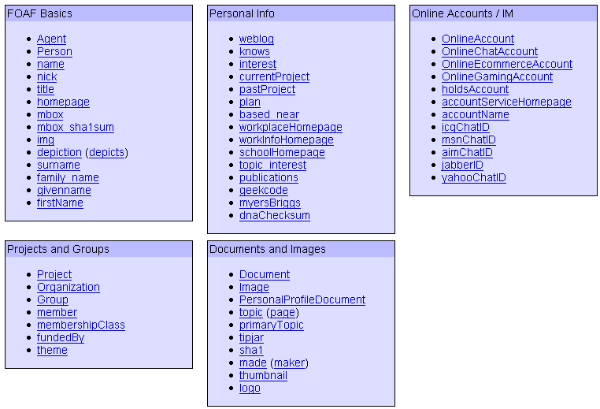
FOAF Vocabulary:
See details at
http://xmlns.com/foaf/0.1/

Slide 68
FOAF: Basic Idea
FOAF aims to create a linked information system about people, groups, and companies.
If people publish information in FOAF document format, machines will be able to make use of that information.
If those files contain “see also” references to other such documents in the Web, we will have a machine-friendly version of today’s hypertext web
FOAF documents are usually represented in RDF.

Slide 69
Basic example
<foaf:Person rdf:about="#me" xmlns:foaf="http://xmlns.com/foaf/0.1/">
<foaf:name>Dan Brickley</foaf:name>
<foaf:mbox_sha1sum>241021fb0e6289f92815fc210f9e9137262c252e</foaf:mbox_sha1sum>
<foaf:homepage rdf:resource="http://danbri.org/" />
<foaf:img rdf:resource="/images/me.jpg" />
</foaf:Person>

Slide 70
FOAF basic concepts
foaf:Agent
An agent (eg., person, group, software or physical artifact)
Subclass: foaf:Person, foaf:Organization, foaf:Group
foaf:Document
Sublcass: foaf:Image
foaf:Person
A person
foaf:Project
A project

Slide 71
FOAF basic properties
foaf:family_name
foaf:firstName
foaf:homepage
foaf:knows
A person known by this person
foaf:mbox
foaf:mbox_sha1sum
foaf:title
Personal title (Mr, Mrs, Ms, Dr, etc.)

Slide 72
Create your own FOAF
<rdf:RDF xmlns:rdf="http://www.w3.org/1999/02/22-rdf-syntax-ns#"
xmlns:rdfs="http://www.w3.org/2000/01/rdf-schema#"
xmlns:foaf="http://xmlns.com/foaf/0.1/"
xmlns:admin="http://webns.net/mvcb/">
<foaf:Person rdf:ID="me">
<foaf:name>Ying Ding</foaf:name>
<foaf:title>Mrs.</foaf:title>
<foaf:givenname>Ying</foaf:givenname>
<foaf:family_name>Ding</foaf:family_name>
<foaf:mbox_sha1sum>f782acba4fc1c1bbecefc41fe2696fa62a84dfe5</foaf:mbox_sha1sum>
<foaf:homepage rdf:resource="www.yingding.com"/>
<foaf:depiction rdf:resource="me.jpg"/>
<foaf:phone rdf:resource="tel:0043-512-5076488"/>
<foaf:workplaceHomepage rdf:resource="www.iu.edu"/>
<foaf:workInfoHomepage rdf:resource="www.iu.edu/ying"/>
<foaf:schoolHomepage rdf:resource="www.uibk.ac.at"/>
<foaf:knows>
<foaf:Person>
<foaf:name>Stefan Decker</foaf:name> <foaf:mbox_sha1sum>1bc1f862b688a45b7e0c8d4a8467c23177c53fad</foaf:mbox_sha1sum>
<rdfs:seeAlso rdf:resource="www.semanticweb.org"/></foaf:Person></foaf:knows>
<foaf:knows>
<foaf:Person>
<foaf:name>Ioan Toma</foaf:name>
<foaf:mbox_sha1sum>1e9f327c5c745341ad13710805961aa739861904</foaf:mbox_sha1sum>
<rdfs:seeAlso rdf:resource="www.ubik.ac.at/Ioan"/></foaf:Person></foaf:knows></foaf:Person>
</rdf:RDF>
http://ldodds.com/foaf/foaf-a-matic.en.html
Fill in your own details
It will create FOAF in RDF

Slide 73
Publish your FOAF description
Save your FOAF RDF file into your website somewhere and name it usually as “foaf.rdf”

Slide 74
FOAF Conclusions
Vocabulary for machine-processable personal homepages
some preliminary tools available
not as successful as social networks such as Facebook, which use proprietary central data
advantage of foaf: decentralized, could serve as exchange format between those existing networks and exists on its own

Slide 75
Apache Jena
a Java API for RDF
Java libraries to develop code that handles RDF, RDFS, RDFa, OWL and SPARQL
Includes a rule-based inference engine to perform reasoning based on OWL and RDFS ontologies
Store RDF triples in memory or on disk

Slide 76
RDFLib
Python library for RDF
https://rdflib.readthedocs.io/en/stable/
Can run entirely in memory

Slide 77
Querying an RDF knowledgebase: SPARQL
Triplestores can also be queried
SPARQL Protocol and RDF Query Language
SQL-like query language
SPARQL is based on matching graph patterns
Triple patterns
Conjunctions
Disjunctions
Optional patterns

Slide 78
SPARQL example
PREFIX abc: <http://example.com/exampleOntology#>
SELECT ?capital ?country
WHERE {
?x abc:cityname ?capital ;
abc:isCapitalOf ?y .
?y abc:countryname ?country ;
abc:isInContinent abc:Africa .

Slide 79
Querying an RDF knowledgebase: SPARQL
SPARQL is based on matching graph patterns
Triple patterns
Conjunctions
Disjunctions
Optional patterns

Slide 80
SPARQL
The simplest graph pattern is the triple pattern
Like an RDF triple, but a variable can replace the subject, predicate, or object
Combining triple patterns gives a basic graph pattern
An exact match to all triple patterns is needed to fulfill the graph pattern

Slide 81
SELECT-FROM-WHERE
As in SQL, SPARQL queries have a SELECT-FROM-WHERE structure:
SELECT specifies the projection: the number and order of retrieved data
FROM is used to specify the source being queried (optional)
WHERE imposes constraints on possible solutions in the form of graph pattern templates and Boolean constraints - conjunctions (AND) and disjunctions (OR)

Slide 82
Example
Get all instances of a particular course:
(declaration of rdf, rdfs prefixes omitted for brevity)
PREFIX uni: <http://www.mydomain.org/uni-ns#>
SELECT ?i
WHERE
{
?i rdf:type uni:course .
}

Slide 83
Example
Retrieve all phone numbers of staff members:
SELECT ?x ?y
WHERE
{ ?x uni:phone ?y .}
Here ?x and ?y are variables, and ?x uni:phone ?y represents a resource-property-value triple pattern

Slide 84
Implicit join
Retrieve all lecturers and their phone numbers
SELECT ?x ?y
WHERE
{
?x rdf:type uni:Lecturer .
?x uni:phone ?y .
}
Restrict the second pattern only to those triples, the resource of which is in the variable ?x

Slide 85
Implicit Join
A more compact of writing the previous query:
SELECT ?x ?y
WHERE
{ ?x rdf:type uni:Lecturer ;
uni:phone ?y . }
a semicolon indicates that the following triple shares its subject with the previous one

Slide 86
Class work
Consider the following fragment of a Semantic Web. There are three kinds of properties:
is-located-in
hasPopulation
rdf:type.
What is the output of the following SPARQL query:
SELECT ?x ?y
WHERE {
?x is-located-in California.
?x hasPopulation ?y.
}
68986
hasPopulation
Davis
is-located-in
California
rdf:type
501901
hasPopulation
Sacramento
is-located-in
City
rdf:type
rdf:type
Phoenix
is-located-in
Arizona
1445632
hasPopulation

Slide 87
Class work (contd.)
Write SPARQL queries to generate the following lists
List of all cities
List of all cities in California
List of all cities, their state, and their population

Slide 88
Optional Patterns
<uni:lecturer rdf:about=“949352”>
<uni:name>Grigoris Antoniou</uni:name>
</uni:lecturer>
<uni:professor rdf:about=“94318”>
<uni:name>David Billington</uni:name>
<uni:email>david@work.example.org</uni:email>
</uni:professor>
For one lecturer it only lists the name
For the other it also lists the email address

Slide 89
Optional Patterns
All lecturers and their email addresses:
SELECT ?name ?email
WHERE
{ ?x rdf:type uni:Lecturer ;
uni:name ?name ;
uni:email ?email .
}

Slide 90
Optional Patterns
SELECT ?name ?email
WHERE
{ ?x rdf:type uni:Lecturer ;
uni:name ?name ;
uni:email ?email .
}
The result:
Grigoris Antoniou is listed as a lecturer, but he has no e-mail address
?name | ?email
David Billington | david@work.example.org

Slide 91
Optional Patterns
Use an optional pattern:
SELECT ?name ?email
WHERE
{ ?x rdf:type uni:Lecturer ;
uni:name ?name .
OPTIONAL { x? uni:email ?email }
}

Slide 92
Optional Patterns
The meaning is roughly “give the names of lecturers, and if known also their e-mail address”
The result:
?name | ?email
Grigoris Antoniou
David Billington | david@work.example.org

Slide 93

Linking Open Data Project
Goal: “expose” open datasets in RDF
Set RDF links among the data items from different datasets
Set up query endpoints
Altogether billions of triples, millions of links…
Notes:
The important point here is that (1) the data becomes available to the World via a unified format (ie, RDF), regardless on how it is stored inside and (2) the various datasets are interlinked together, ie, they are not independent islands. Dbpedia is probably the most important 'hub' in the project.

Slide 94


Example data source: DBpedia
DBpedia is a community effort to
extract structured (“infobox”) information from Wikipedia
provide a query endpoint to the dataset
interlink the DBpedia dataset with other datasets on the Web

Slide 95
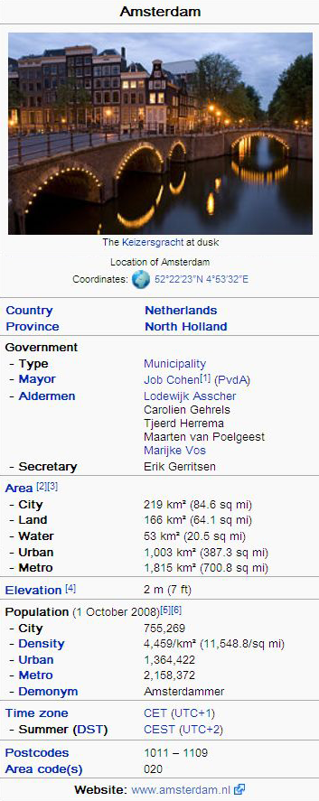
Extracting Wikipedia structured data
@prefix dbpedia <http://dbpedia.org/resource/>.
@prefix dbterm <http://dbpedia.org/property/>.
dbpedia:Amsterdam dbterm:officialName “Amsterdam” ; dbterm:longd “4” ;
dbterm:longm “53” ;
dbterm:longs “32” ;
... dbterm:leaderTitle “Mayor” ; dbterm:leaderName dbpedia:Job_Cohen ;
...
dbterm:areaTotalKm “219” ;
...
dbpedia:ABN_AMRO
dbterm:location dbpedia:Amsterdam ;
...
Notes:
The right hand portion of the wiki side is what is referred to as 'infobox'. The left side is the dbpedia content as made available.

Slide 96
DBpedia SPARQL Explorer
https://www.dbpedia.org/
https://dbpedia.org/sparql
https://dbpedia.org/snorql/

Slide 97
Sample SPARQL queries
SELECT ?pop
WHERE {
dbr:India dbo:populationTotal ?pop.
}
SELECT ?country
WHERE {
?country a dbo:Country .
?country rdfs:label "India"@en.
}
SELECT ?country ?pop
WHERE {
?country a dbo:Country .
?country rdfs:label "India"@en.
?country dbo:populationTotal ?pop.
}
# List all properties and objects associated with the country "India"
SELECT ?country ?prop ?pop
WHERE {
?country a dbo:Country .
?country rdfs:label "India"@en.
?country ?prop ?pop.
}
# List all countries with population greater than 10,0000,000 (without filter)
SELECT ?country ?name ?pop
WHERE {
?country a dbo:Country .
?country rdfs:label ?name.
?country dbo:populationTotal ?pop.
FILTER (?pop > 100000000).
}
# List all countries with population greater than 10,0000,000
SELECT ?country ?name ?pop
WHERE {
?country a dbo:Country .
?country rdfs:label ?name.
FILTER (lang(?name) = "en").
?country dbo:populationTotal ?pop.
FILTER (?pop > 100000000).
}

Slide 98
Class work
Write SPARQL queries to:
List all countries and their capital cities
Hint: use property dbo:capital
Get the capital of Japan
List all countries with population greater than 10,0000,000, and their capital cities
What are the languages spoken in both India and Pakistan
Hint: use property dbo:language

Slide 99
Automatic links among open datasets
<http://dbpedia.org/resource/Amsterdam> owl:sameAs <http://rdf.freebase.com/ns/...> ;
owl:sameAs <http://sws.geonames.org/2759793> ;
...
<http://sws.geonames.org/2759793>
owl:sameAs <http://dbpedia.org/resource/Amsterdam>
wgs84_pos:lat “52.3666667” ;
wgs84_pos:long “4.8833333” ;
geo:inCountry <http://www.geonames.org/countries/#NL> ;
...
Processors can switch automatically from one to the other…
Notes:
This is the important point: this is why this is Linking open data. What the community does (and this is a community project) is to make agreements on how the different datasets can be linked and then the linkage is done automatically by the 'bridges' that map the public datasets into RDF. Eg, geonames is a public dataset by geonames.org and dbpedia is, well... wikipedia:-)

Slide 100
RDF Summary
RDF provides a foundation for representing and processing metadata
RDF has a graph-based data model
RDF has an XML-based syntax to support syntactic interoperability
XML and RDF complement each other because RDF supports semantic interoperability
RDF allows incremental building of knowledge, and its sharing and reuse
RDF is domain-independent
- RDF Schema provides a mechanism for describing specific domains
RDF Schema is a primitive ontology language
It offers certain modelling primitives with fixed meaning
Key concepts of RDF Schema are class, subclass relations, property, subproperty relations, and domain and range restrictions
SPARQL is a query language for RDF and RDFS

Slide 101
RDFS as an Ontology Language
RDFS is recognisable as an ontology language
Classes and properties
Sub/super-classes (and properties)
Range and domain (of properties)

Slide 102
RDFS as an Ontology Language
RDFS is recognisable as an ontology language
Classes and properties
Sub/super-classes (and properties)
Range and domain (of properties)
But RDFS too weak to describe resources in sufficient detail, e.g.:
No existence/cardinality constraints
No transitive, inverse or symmetrical properties
No localised range and domain constraints
…
OWL: a more sophisticated ontology language

Slide 103
Logical entailment

Slide 104
Acknowledgement
“A semantic Web primer,” by Frank van Harmelen and G. Antoniou
“FOAF,” by Ying Ding, Indiana University
“Introduction to the Semantic Web (tutorial),” by Ivan Herman, W3C

